Slide 1
Software Engineering and Architecture
Deriving State Pattern
Combining Behavior

Slide 2
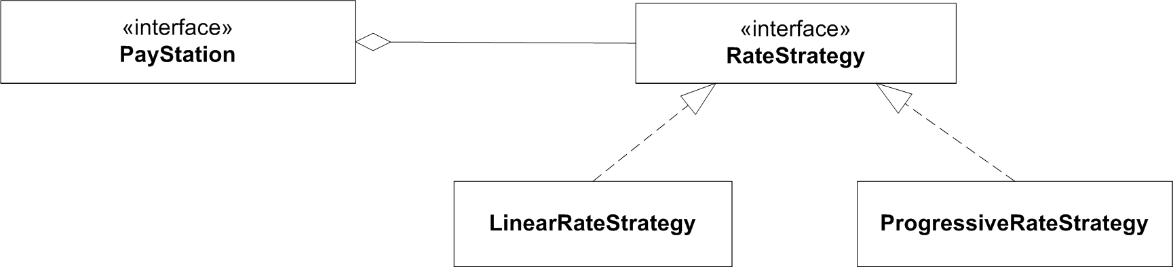
New requirement
Gammatown County wants:
“In weekdays we need Alphatown rate (linear);
in weekends Betatown rate (progressive)”

Slide 3

Exercise
“In weekdays we need Alphatown rate (linear);
in weekends Betatown rate (progressive)”
Exercise: How?

Slide 4
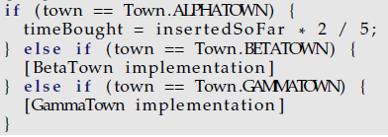
Same Analysis
Model 1:
  Source tree copy
    Now three copies to maintain
Model 2:
  Parametric
Model 3:
  Polymorphic – but ???
Model 4:
  Compositional – but how?

Slide 5
But…
I will return to the analysis shortly, but first…
I have a problem!
  I want to do TDD – because automated tests feel good…
  But how can I write test first when the outcome of a GammaTown rate strategy… depends on the day of the week???

Slide 6
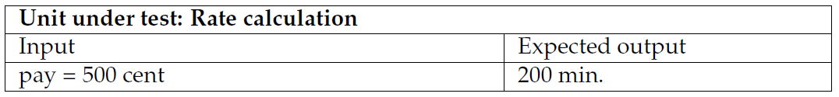
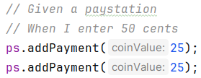
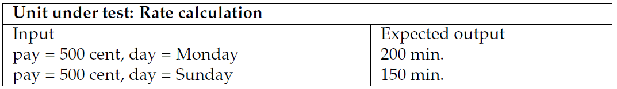
Tricky Requirement
The test case for AlphaTown:
… but how does it look for GammaTown?
, Monday) ???

Slide 7
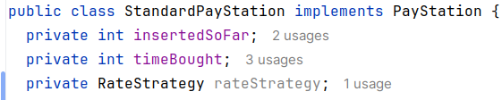
Direct and Indirect Parameters
The day of the week is called an indirect parameter to the calculateTime method
  It is not an instance variable
  of the object
  It is not a parameter to the method
  It cannot be set by our JUnit code ☹
    It is ‘set’ by the computer’s clock
      That is, a parameter set indirectly by something outside our JUnit test code…

Slide 8
Solutions?
So – what to do?
  Come in on weekends?
    Manual testing!
  Set the clock ?
    Manual testing!
    Messes up Gradle as it depends on the clock going forward!
  Refactor code to make Pay Station accept a Date object?
    No – pay stations must continuously ask for date objects every time a new coin is entered…
I will return to this problem set soon…
I initially do this in the book…

Slide 9
Polymorphic Solutions to the GammaTown Challenge
Using class inheritance

Slide 10
Premise
Let us assume that we have developed the polymorphic solution to handle BetaTown!
That is: forget the Strategy based solution we did last time for the next analysis...

Slide 11
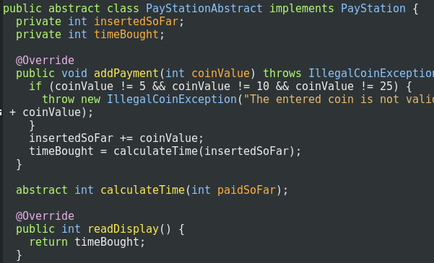
Reviewing the Polymorphic
So – how did the polymorphic solution look like:
  Make PayStationImpl abstract, calculateTime abstract
  Two subclasses, one for linear and one for progressive
abstract

Slide 12
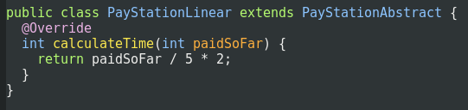
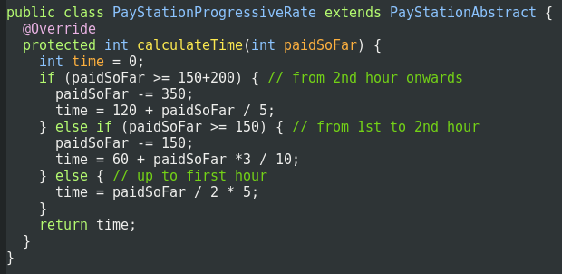
The Concrete Classes
AlphaTown = Linear
BetaTown = Progressive

Slide 13
The Big Challenge
How do I make a subclass
which has both these
algorithms?
  They are in two different classes!!!

Slide 14
Our Polymorphic Options
Insisting on subclasses,
what can we do?

Slide 15
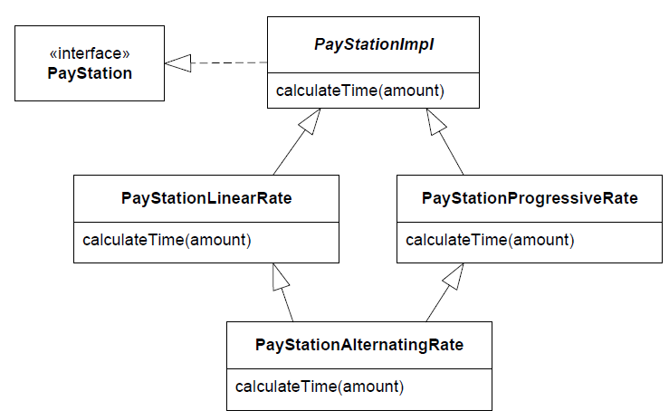
Model 3a: Multiple Inheritance
Subclass and override!
Could work in C++, but not Java(*) or C#;
  My experience with fork-join hierarchies in C++ are bad ☹
C++ Code
If (isWeekend()) {
PSProgressive::calcTime(…);
} else {
PSLinear::calcTime(…);
}

Slide 16
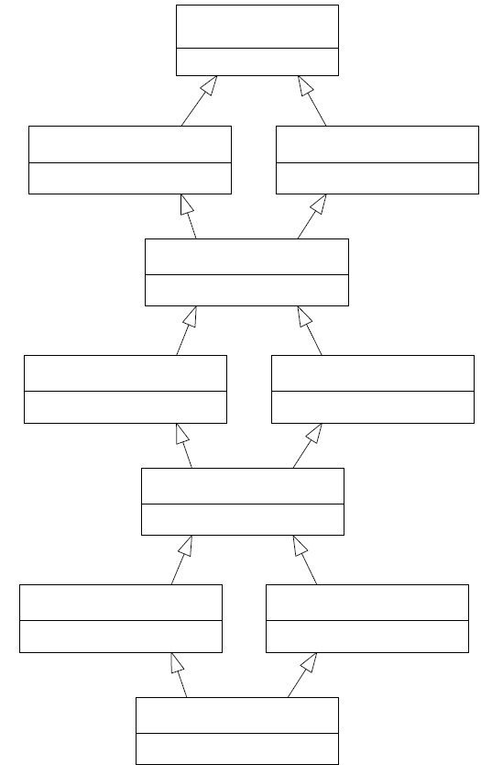
Fork-Join Hierarchies
This is a fork-join hierarchy
Fork-join =
  A root class – that has
  Two subclasses – that
  A single class inherit from – that has
  Two subclasses – that
  …
My experience is … bad…
Notes:
Peter Juhl from AT&T Bell Labs helped me with early C++ fork-join headaches

Slide 17
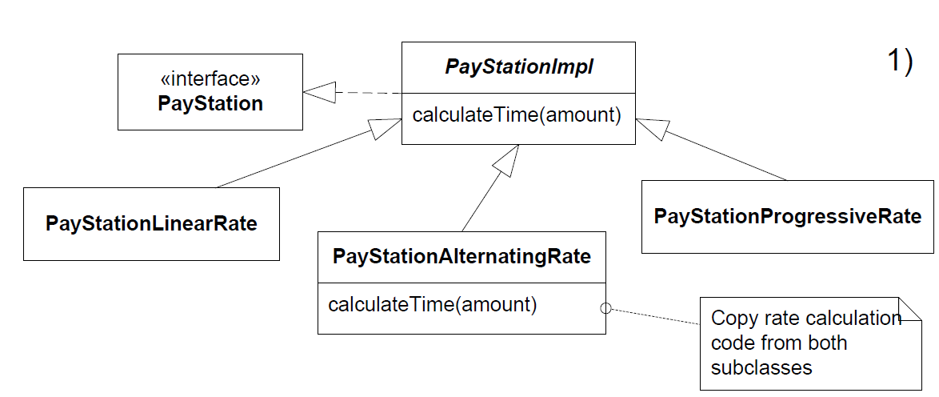
Model 3b: Direct Subclass
Cut code from linear and progressive, paste into alternating… And we have multiple copies of code…

Slide 18
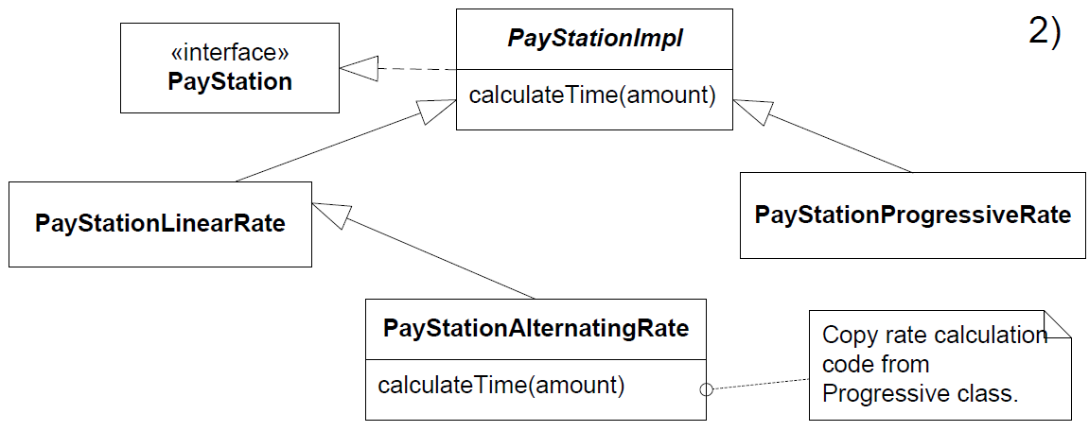
Model 3c:Sub-sub Class
Cut code from progressive, paste into alternating

Slide 19
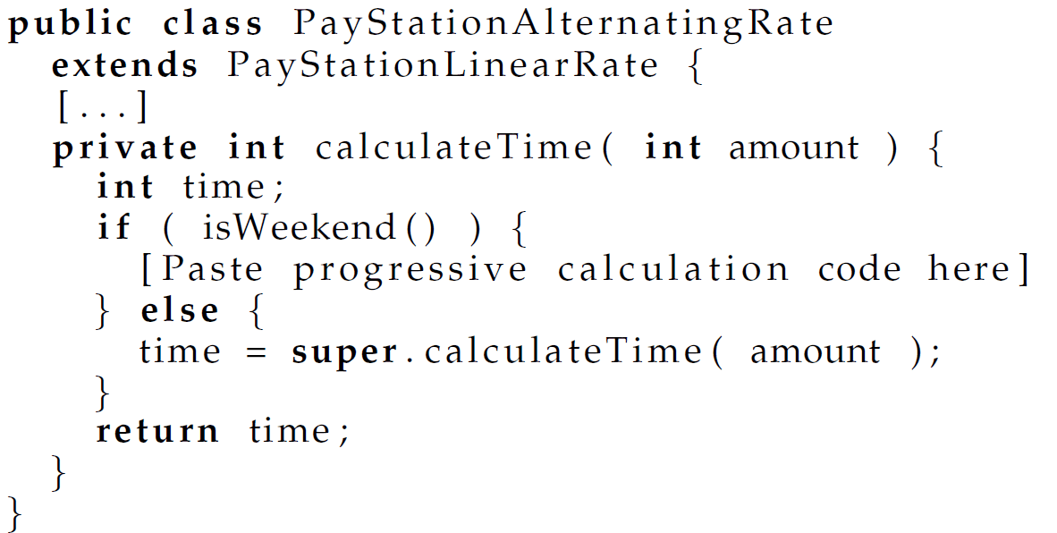
Code view
Only half as much code duplication as before
  You are kidding?
    Example of a ‘better’ solution, that is really ‘bad’ ☺

Slide 20
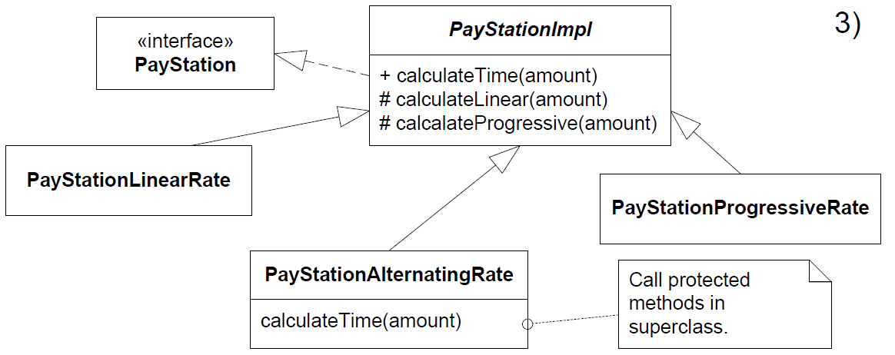
Model 3d: Bubbling up/Superclass
Make protected calculation methods in abstract PayStationImpl, and call these from Alternating
  This is a classic solution often seen in practice

Slide 21
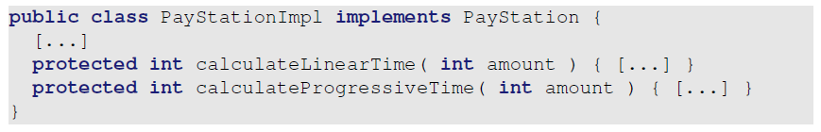
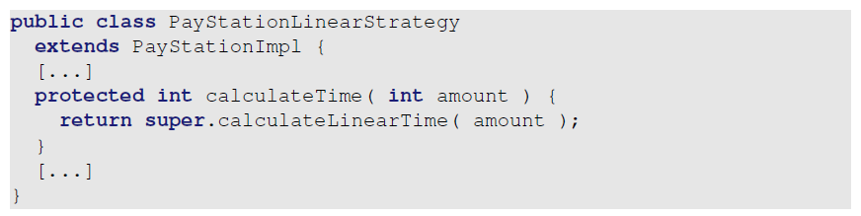
Code view
The super class
Alpha then becomes

Slide 22
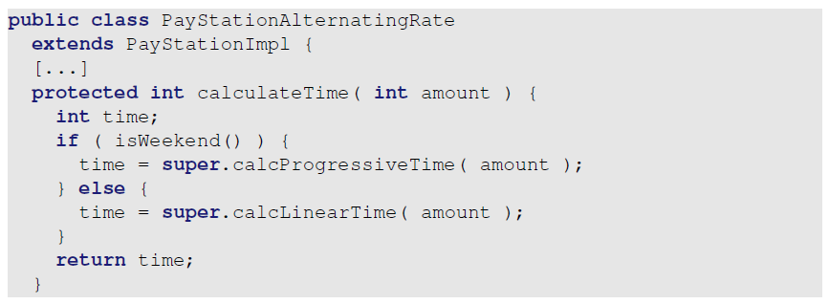
Code view
Gamma is then
Discussion
  No code duplication
  Exercise: what are the liabilities?

Slide 23
Liabilities
Superclass stability
  Tendency to modify super classes repeatedly
Superclass analyzability and cohesion
  Becomes a junk pile of methods over time
  The methods are unrelated to the superclass itself, it is just a convenient “parking lot” for them
  This is an example of an abstraction with little cohesion
  Over time, becomes grave-yard of forgotten methods?

Slide 24
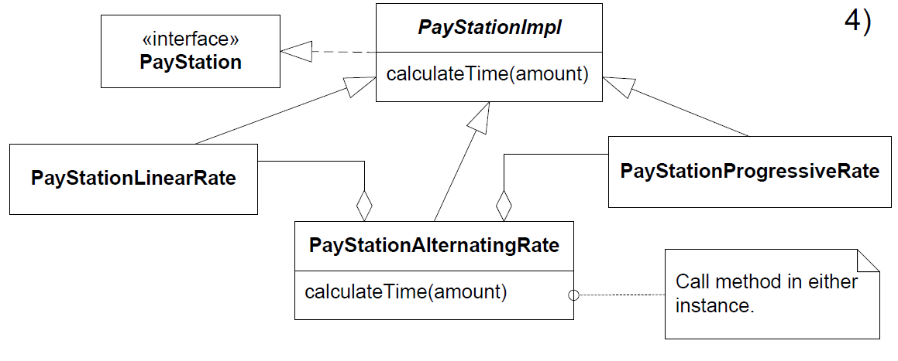
Model 3e: Stations in Stations
A student proposed this one…

Slide 25
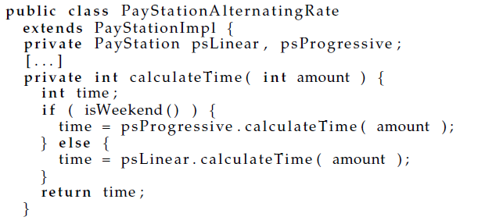
Model 3e: Stations in Stations
The “pay stations in pay station” way:
  Create a gamma pay station containing both an alpha and beta pay station
Exercise: Benefits and liabilities?
Notes:
Solves the problem, BUT
Multiple states to keep consistent
Does not really match my intuition of reality
More space consumption in memory

Slide 26
Morale
It simply does not work cleanly!
I have never seen a polymorphic solution that handles this very simple requirement in a natural and concise way!
Like in other design disciplines, we like elegance ☺

Slide 27
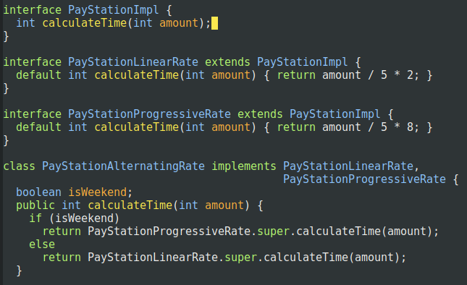

(*) SideBar
Multiple inheritance of implementation is evil IMO…
Java 8 managed to sneak it in anyway ☹
  Default methods
Do not use default methods for fork-join hierarchies. It is not its intended use!
(Library evolution is)

Slide 28
Compositional Variants

Slide 29
Premise
Now, please reset your minds again!
We now look at the compositional variant (strategy pattern) that we made the last time!

Slide 30
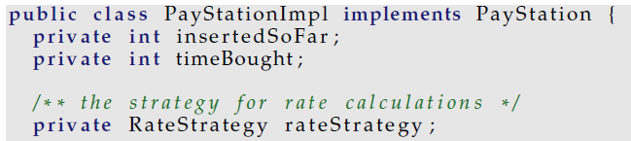
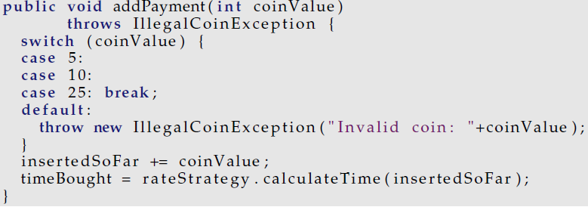
Code View

Slide 31
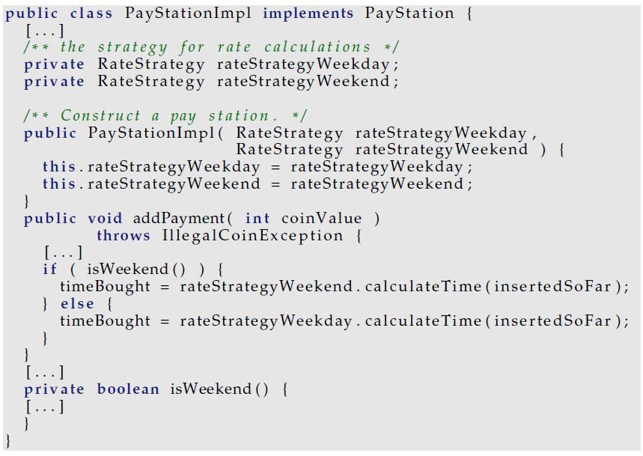
Model 4a: Parameter + compositional

Slide 32
Model 4a: Parameter + compositional
Liabilities
  Code change in the constructor
  Constructor has become really weird for alpha and beta
Worse: we have just blown the whole idea!
  now the pay station has resumed the rate calculation responsibility 
  or even worse – the responsibility is distributed over several objects   
    The responsibility to know about rate calculations are now distributed into two objects – leading to lower analyzability
    leads to duplicated code, and bugs difficult to track.

Slide 33
Model 4b: Copy and paste version
Cut and paste the code into new strategy object
Multiple maintenance problem 
  a bug in price calculation functionality must be corrected in two places – odds are you only remember one of them.
GammaAlternatingRateStrategy

Slide 34
Lesson Learned
Often two variability techniques are used at the same time
  Polymorphic + parametric
  Polymorphic + source-code copy
  …
… Which somewhat masks there is a bit issue here
Do the same thing, the same way !!!
  If your variability technique does not support it – it is because you are using the wrong technique ☺

Slide 35
… on to a nice compositional solution: State pattern
Composition is doing the same thing the same way

Slide 36
Compositional Idea
③ I identify some behavior that varies.
  The rate calculation behavior is what must vary for Gammatown and this we have already identified.
① I state a responsibility that covers the behavior that varies and encapsulate it by expressing it as an interface.
  The RateStrategy interface already defines the responsibility to “Calculate parking time” by defining the method calculateTime.
② I compose the resulting behavior by delegating the concrete behavior to subordinate objects.
  This is the point that takes on a new meaning concerning our new requirement.

Slide 37
Model 4
Compose the behavior...
That is:
  the best object to calculate linear rate models has already been defined and tested – why not use its expertise ? Same goes with progressive rate.
  so let us make a small team – one object responsible for taking the decision; the two other responsible for the individual rate calculations.

Slide 38
The Cartoon
Team leader
rate calculation request
Rate Policy Expert
Linear
2.delegate to expert
1. check clock
Rate Policy Expert
Progressive

Slide 39
Interpretation
Note:
From the Pay Station’s viewpoint the behavior of the ”team leader” change according to the state of the clock!
Pay Station
Team leader
rate calculation request

Slide 40
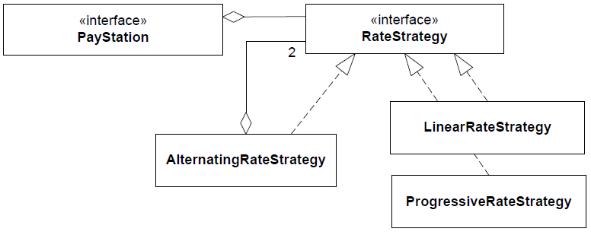
Clock State Define Behavior
Reusing existing, well tested, classes...

Slide 41
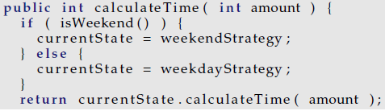
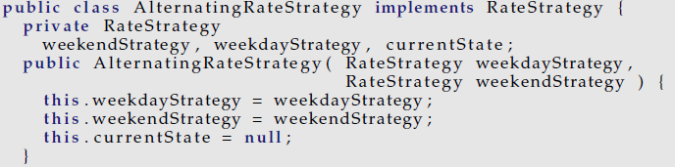
Code view
In AlternatingRateStrategy:
1. check clock,
choose expert to use
2. delegate to expert
In AlternatingRateStrategy: Construction

Slide 42
Analysis
Consequence:
  Minimal new code, thus very little to test
    most classes are untouched, only one new is added.
  Change by addition, not modification
  No existing code is touched
    So, no new testing
    No review
  Parameterization of constructor
    All models possible that differ in weekends...

Slide 43
Roles revisited
This once again emphasizes the importance of
  ③ Encapsulate what varies: the rate policy
  ① Define well-defined responsibilities by interfaces
  ① Only let objects communicate using the interfaces
    Then the respective roles (pay station / rate strategy) can be played by many difference concrete objects
    And each object is free to implement the responsibilities of the roles as it sees fit – like our new ‘team leader’ that does little on his own!
  ② also to let most of the dirty job be done by others ☺
    Delegate concrete calculations to the two rate specialists

Slide 44
The State Pattern

Slide 45
Analysis
Yet another application of 3-1-2
  (but note that the argumentation this time was heavily focused on the ② aspect: composing behavior by delegating to partial behavior)
Rephrasing what the Gammatown pay system does:
  The rate policy algorithm alters its behavior according to the state of the system clock

Slide 46
State Pattern
State pattern intent
  Allow an object to alter its behavior when its internal state changes. The object will appear to change its class.
  The rate policy algorithm alters its behavior according to the state of the system clock
  Seen from the PayStationImpl the AlternatingRateStrategy object appears to change class because it changes behavior over the week.

Slide 47
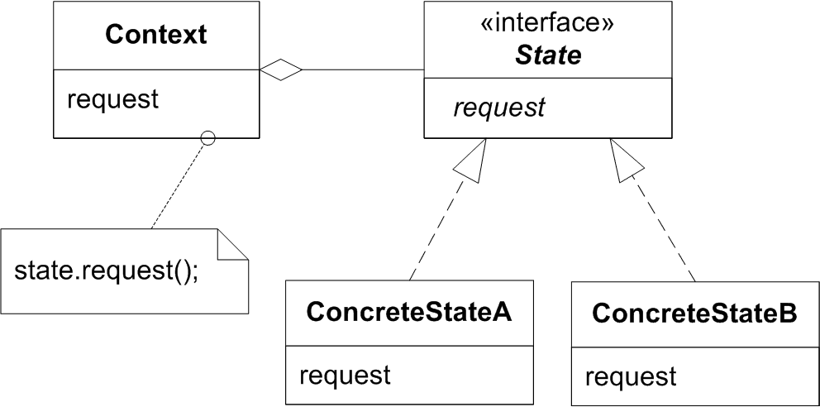
Roles
Context delegate to its current state object
State specifies responsibilities of the behavior that varies according to state
ConcreteState defines state specific behavior
State changes?
  May be defined either in Context or in ConcreteState set
  That who defines it is less reusable

Slide 48
Exercise
Which object/interface fulfil which role in the pay station?
Who is responsible for state changes?

Slide 49
Benefits/Liabilities of State
General
  State specific behavior is localized (high cohesion)
    in a single ConcreteState object
  State changes are explicit
    as you just find the assignments of ‘currentState’
  Increased number of objects
    as always with compositional designs
Compare common state machines:
  case INIT_STATE:
  case DIE_ROLL_STATE:
  case MOVE_CHECKERS_STATE:

Slide 50
Examples
All state machines can be modelled by the state pattern
  and looking for them there are a lot
  TCP Socket connection state
  any game has a state machine
  Protocols
  etc...

Slide 51
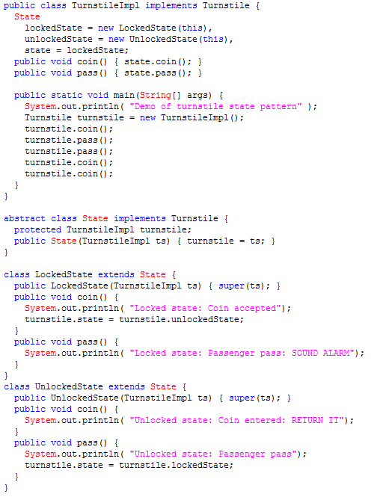
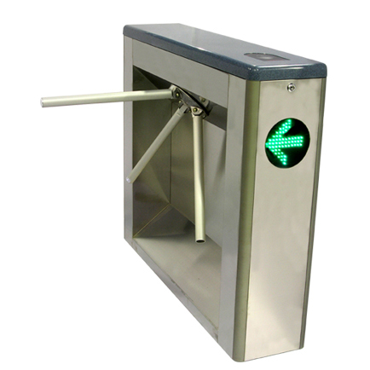
Example: Turnstile

Slide 52
Summary
New requirement
  a case that screams for reusing existing and well-tested production code
  cumbersome to utilize the reuse potential especially in the sub-classing case (deeper discussion in the book)
  but handled elegantly by compositional design
    think in terms of teams of objects playing different roles
  I derived the State pattern
    more general pattern handling state machines well

